Slide 1

Alzheimer's disease Prediction using Deep Learning.
Project Presentation
By
Enrollment Number Student Name
Guided By
Prof. Revati Deshpande
Enrollment Number | Name of Student
MITU22BTCSD041 | Shaaz Mukadam
MITU21BTCS072 | Vishal Sakale
MITU21BTCS0004 | Aadityanarayan Jha
MITU21BTCS0420 | Pratham Desai
Department of Computer Science & Engineering, MITSoC, Loni Kalbhor

Slide 2
Outline
1 INTRODUCTION
2 CONCEPTS AND METHODS
3 LITERATURE SURVEY
4 PROJECT PLAN
5. SOFTWARE REQUIREMENT SPECIFICATION
6 RESULTS
7 CONCLUSION AND FUTURE WORK
Department of Computer Science & Engineering, MITSoE, Loni Kalbhor

Slide 3
1. Introduction
Alzheimer's disease is a brain disorder that slowly destroys memory and thinking skills and, eventually, the ability to carry out the simplest tasks. In most people with the disease — those with the late-onset type symptoms first appear in their mid-60s.
There are 4 categories
Mild Dementia.
Moderate Dementia
Non Dementia
Very Mild Dementia
Mild Dementia: Signs and symptoms of mild dementia include memory loss, confusion about the location of familiar places, taking longer than usual to accomplish normal daily tasks
Moderate Dementia: During the moderate dementia stage of Alzheimer's disease, people grow more confused and forgetful.
Department of Computer Science & Engineering, MITSoE, Loni Kalbhor

Slide 4
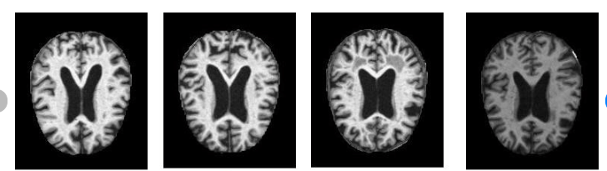
Non Dementia: The non-AD group of dementias include a variety of disorders characterized by pathological changes involving various cortical and subcortical circuits.
Very Mild Dementia: Signs and symptoms of mild dementia include memory loss, confusion about the location of familiar places.
Mild Dementia
Moderate Dementia
Mild Dementia
Very Mild Dementia

Slide 5
2. Problem Statement
Alzheimer's disease Prediction using Deep Learning.
Department of Computer Science & Engineering, MITSoE, Loni Kalbhor

Slide 6
3. Objectives
1.Data Collection and Preprocessing:
Gather a diverse dataset comprising medical records, neuroimaging data, genetic information, and demographic details of patients, including those diagnosed with Alzheimer's and a control group of healthy individuals.
2.Model Development:
Design and train a sophisticated deep learning model, possibly leveraging architectures like convolutional neural networks (CNNs), recurrent neural networks (RNNs), or transformer-based models, to analyze complex patterns and relationships within the data and accurately predict the likelihood of Alzheimer's disease.
3.Comparison with Existing Methods:
Compare the performance of the deep learning model with traditional machine learning techniques and existing clinical assessment methods to demonstrate the model's superiority in terms of accuracy, efficiency, and reliability.
Department of Computer Science & Engineering, MITSoE, Loni Kalbhor

Slide 7
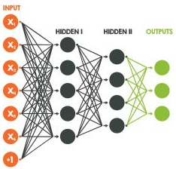
4. Concepts and Methods
Concept: Image Pre-processing
Image processing involves performing operations on an image to make it better or to get important information from it. It's like fixing or improving a picture, and it's a bit like working with signals. The input is an image, and the output can be a better image or some important details from the image.
Method: Convolution Neural Network (CNN):
A Convolutional Neural Network (CNN) is a type of deep learning algorithm that is particularly well-suited for image recognition and processing tasks.
It is made up of multiple layers, including convolutional layers, pooling layers, and fully connected layers
CNNs are trained using a large dataset of labeled images, where the network learns to recognize patterns and features that are associated with specific objects or classes.
Department of Computer Science & Engineering, MITSoE, Loni Kalbhor

Slide 8
5. Literature Survey
 | Title | Author | Method used Techniques / technology(s/w & h/w) | Dataset used | Result | Result compared with | Future work
1 | Alzheimer’s disease · Feature fusion · MRI · PET · Heuristic methods · Deep learning(M) |  | PET and MRI images, while a modified Resnet18 deep learning architecture is trained simultaneously on the two datasets. | We used the Alzheimer’s Disease Neuroimaging (ADNI) database in this study. | Accuracy of 73.90% on the ADNI database. | The modified Resnet18 deep learning architecture | Further research is needed to optimize the use of these models in clinical practice
2 | Cardiovascular Risk Factors and Incident Alzheimer Disease | Christiana Parnell, BA, | Risk factors included hypertension, diabeteslex vitamins, homocysteine, stroke, atrial fibrillation, apolipoprotein E (APOE), lipids, and diet. | oasis longitudinal dataset. | Accuracy of 82.20% on the ADNI database. | The modified Resnet18 deep learning architecture
3 | Alzheimer’s disease · Feature fusion · MRI · PET · Heuristic methods · Deep learning(M) | Jose Luis Molinuevo | PET and MRI images, while a modified Resnet18 deep learning architecture is trained simultaneously on the two datasets. | oasis longitudinal dataset. | Accuracy of 93.20% on the ADNI database. | Further research is needed to optimize the use of these models in clinical practice
Department of Computer Science & Engineering, MITSoE, Loni Kalbhor

Slide 9




6. Tools and Languages
Languages : Python
Python is a general-purpose high level programming language that is widely used in data science and for producing deep learning algorithms.
Most popular programming language for Machine Learning due to its readability, extensive libraries and frameworks, strong community support, compatibility with other languages and scalability.
Tools: NumPy, TensorFlow, Keras , PyTorch, Pandas, Matplotib, etc
Department of Computer Science & Engineering, MITSoE, Loni Kalbhor

Slide 10
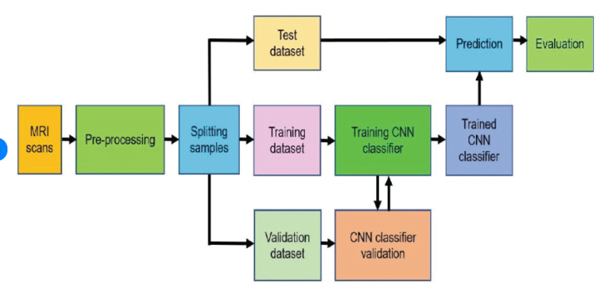




7. Process and Architecture
Department of Computer Science & Engineering, MITSoE, Loni Kalbhor

Slide 11
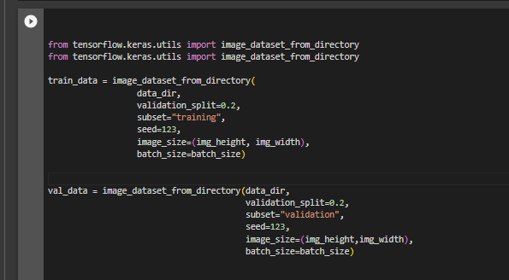
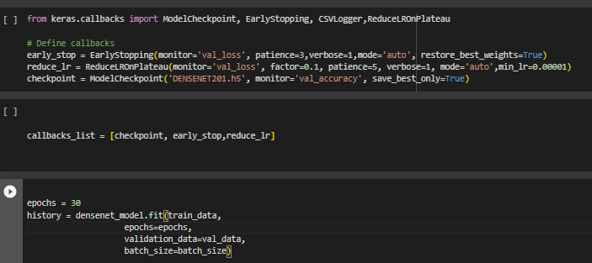
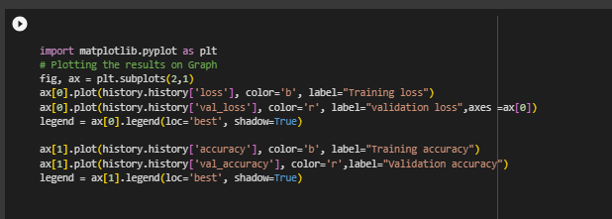
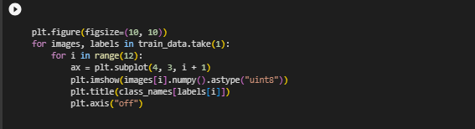
8. Implementation
Department of Computer Science & Engineering, MITSoE, Loni Kalbhor

Slide 12
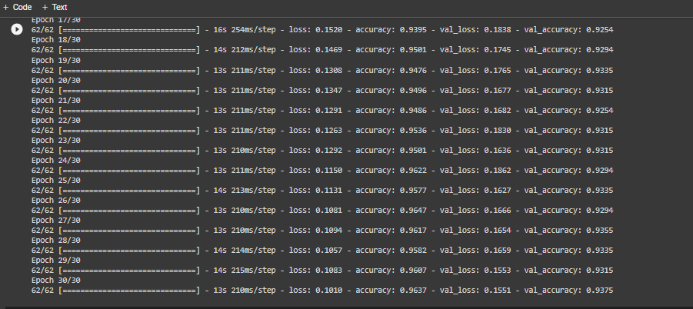
9. Results
Here we set 30 Epoch and it run successfully with 0.9375 accuracy it means 93% accuracy with this dataset
Department of Computer Science & Engineering, MITSoE, Loni Kalbhor

Slide 13
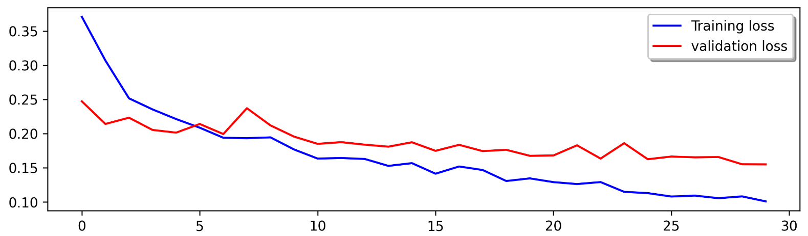
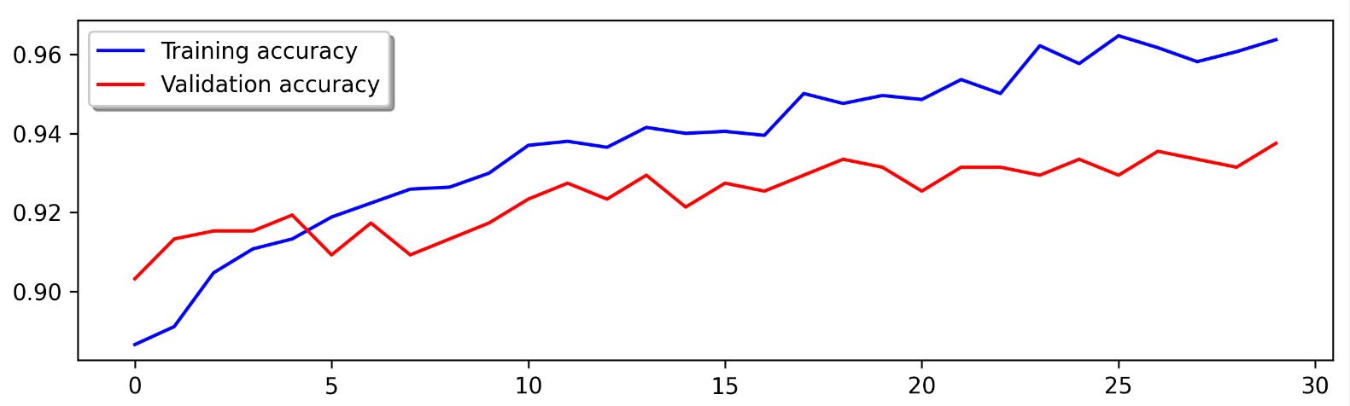
9. Results Graph
Department of Computer Science & Engineering, MITSoE, Loni Kalbhor

Slide 14
10. Conclusion and Future Work
So the accuracy of this model using this dataset is 93% ,we are trying to increase its accuracy upto 99% and in this we used normal dataset from Kaggle , but in future we are going to use the dataset from the official diseases prediction website of government.
Reference Link of government website:
https://healthdata.gov/dataset/Alzheimer-s-Disease-and-Healthy-Aging-Data/i2i7-abim
Department of Computer Science & Engineering, MITSoE, Loni Kalbhor

Slide 15
References
[1] C.A. Lane, J. Hardy, J.M. Schott, Alzheimer’s disease, Eur. J. Neurol. 25 (1) (2017)59–70.
[2] Alzheimer’s Disease International (AZ) World Alzheimer Report 2016,Alzheimer’s Disease International, London, UK, https://www.alz.co.uk/research/WorldAlzheimerReport2016.pdf/, 2016. (Accessed 12 December 2017).
[3] L. Minati, T. Edginton, M. Grazia Bruzzone, G. Giaccone, Reviews: current conceptsin Alzheimer’s disease: a multidisciplinary review, Am. J. Alzheimer’s Dis. OtherDement. 24 (2) (2009) 95–121.
[4] G.B. Frisoni, N.C. Fox, C.R. Jack Jr., P. Scheltens, P.M. Thompson, The clinical useof structural MRI in Alzheimer disease, Nat. Rev. Neurol. 6 (2) (2010) 67.
[5] B. Deweer, S. Lehericy, B. Pillon, M. Baulac, J. Chiras, C. Marsault, Y. Agid, B.Dubois, Memory disorders in probable Alzheimer’s disease: the role of hippocam-pal atrophy as shown with MRI, J. Neurol. Neurosurg. Psychiatry 58 (5) (1995)590–597.
[6] B.C. Dickerson, I. Goncharova, M. Sullivan, C. Forchetti, R. Wilson, D. Bennett,L.A. Beckett, L. deToledo Morrell,
Department of Computer Science & Engineering, MITSoE, Loni Kalbhor

Slide 16
Thank You
Department of Computer Science & Engineering, MITSoE, Loni Kalbhor

Slide 17
Questions
Department of Computer Science & Engineering, MITSoE, Loni Kalbhor

